Slide 1
Trees, forests and ENSEMBLES
Arunabh – LHL Jan 2021 Cohort East

Slide 2
Go To the link and keep selecting an option till you reach the edge(Leaf) of the tree
https://live.yworks.com/demos/complete/decisiontree/
http://www.r2d3.us/visual-intro-to-machine-learning-part-1/

Slide 3
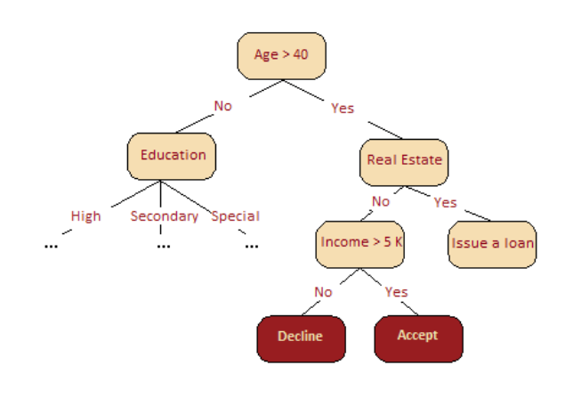
What is a decision Tree
A decision tree is often a generalization of the experts' experience, a means of sharing knowledge of a particular process.
For example, before the introduction of scalable machine learning algorithms, the credit scoring task in the banking sector was solved by experts.
The decision to grant a loan was made on the basis of some intuitively (or empirically) derived rules that could be represented as a decision tree.
Source: Yorko Open ML Course

Slide 4
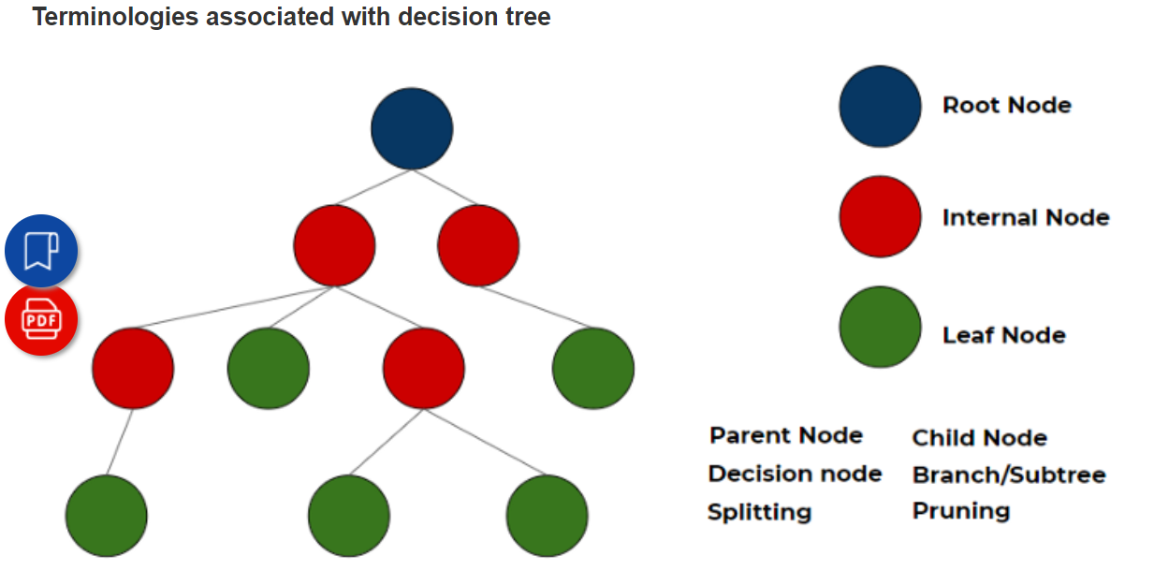
Terminology
Source: Analytics Vidhya

Slide 5
Types of nodes
Parent node: In any two connected nodes, the one which is higher hierarchically, is a parent node.
Child node: In any two connected nodes, the one which is lower hierarchically, is a child node.
Root node: Starting node from which the tree starts, It has only child nodes. The root node does not have a parent node. (dark blue node in the above image)
Leaf Node/leaf: Nodes at the end of the tree, which do not have any children are leaf nodes or called simply leaf. (green nodes in the above image)
Internal nodes/nodes: All the in-between the root node and the leaf nodes are internal nodes or simply called nodes. internal nodes have both a parent and at least one child. (red nodes in the above image)
Splitting: Dividing a node in two or more sun-nodes or adding two or more children to a node.
Decision node: when a parent splits into two or more children nodes then that node is called a decision node.
Pruning: When we remove the sub-node of a decision node, it is called pruning. You can understand it as the opposite process of splitting.
Branch/Sub-tree: a subsection of the entire tree is called a branch or sub-tree.
Source: Analytics Vidhya

Slide 6
How Do You Create a decision tree?
Biggest question. Where do you start from?
We cant arbitrarily choose a root node. So how we decide what should be our root node? Which feature do we look at to make the first split?
Think of the game ‘GUESS the CELEBRITY’. You have 20 questions to guess the celebrity I am thinking of.
I will only answer in yes or no’s. Then you ask the next question.
Obviously the first question should tell you most about a celebrity. So the first question should be if the person is a male or a female as this gives us maximum information gain.
Source: Yorko Open ML Course

Slide 7
Classification and regression trees (CART)
Decision trees can perform both classification and regression.
A regression tree is used when the dependent variable is continuous.
The value obtained by leaf nodes in the training data is the mean response of observation falling in that region.
Thus, if an unseen data observation falls in that region, its prediction is made with the mean value.
A classification tree is used when the dependent variable is categorical.
The value obtained by leaf nodes in the training data is the mode response of observation falling in that region

Slide 8
Gini impurity
Biggest question. Where do you start from?
The decision of making strategic splits heavily affects a tree’s accuracy.
The purity of the node should increase with respect to the target variable after each split.
According GINI Method, we make sure that when select to random samples from our dataset they belong to same target class.
GINI only performs binary splits. It only divides the node into 2 nodes not more than that.
Higher the value of gini at a split, higher the homogeneity of points.
Source: Analytics Vidhya

Slide 9
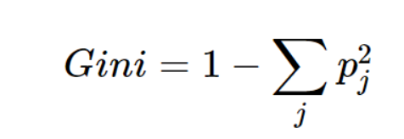
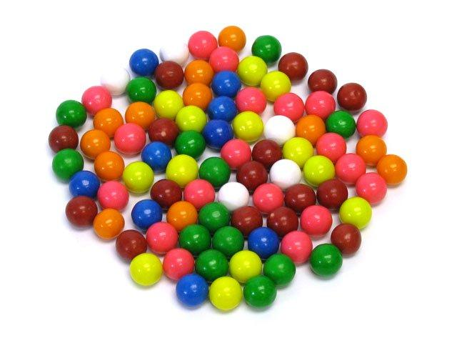
GINI Explained with an example
If we have 4 red gumballs and 0 blue gumballs, that group of 4 is 100% pure.
If we have 2 red and 2 blue, that group is 100% impure.
If we have 3 red and 1 blue, that group is either 75% or 81% pure, if we use Gini or Entropy respectively.
Source: https://towardsdatascience.com/gini-index-vs-information-entropy-7a7e4fed3fcb

Slide 10
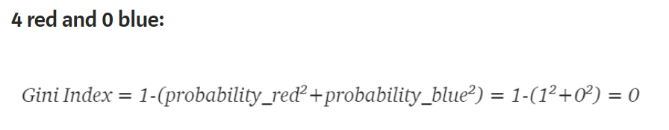
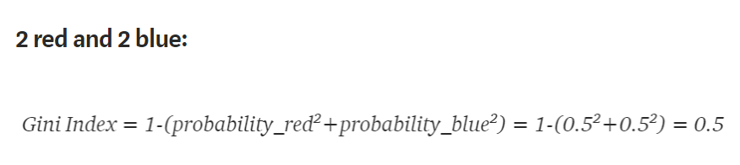
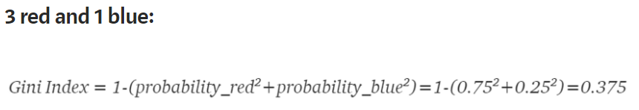
GINI Calculations in the previous 3 examples
Source: https://towardsdatascience.com/gini-index-vs-information-entropy-7a7e4fed3fcb

Slide 11
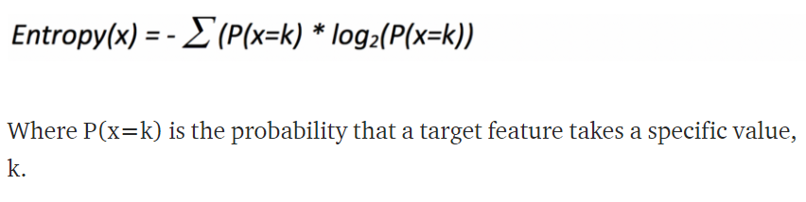
Entropy
Also used to measure the impurity or randomness of a dataset.
Where P(x=k) is the probability that a target feature takes a specific value, k
Logarithm of fractions gives a negative value and hence a ‘-‘ sign is used in entropy formula to negate these negative values.
The maximum value for entropy depends on the number of classes.
2 classes: Max entropy is 1. 4 classes: Max entropy is 2 and so on.
Source: https://towardsdatascience.com/gini-index-vs-information-entropy-7a7e4fed3fcb

Slide 12
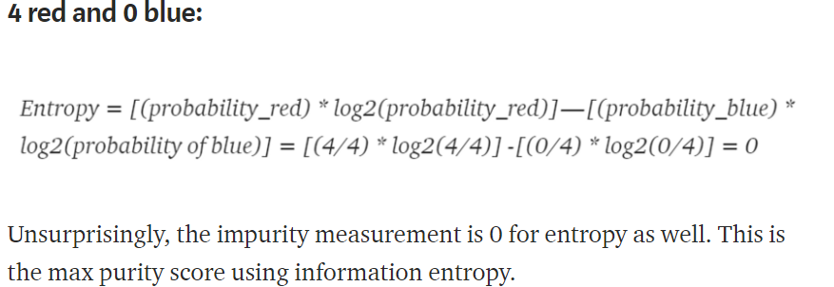
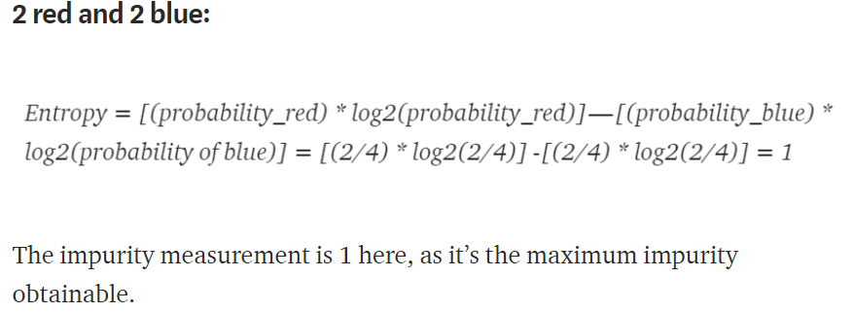
ENTROPY EXAMPLE

Slide 13
Advantages and disadvantages of decision trees
Easy to visualize and interpret: Its graphical representation is very intuitive to understand and it does not require any knowledge of statistics to interpret it.
Useful in data exploration: We can easily identify the most significant variable and the relation between variables with a decision tree. It can help us create new variables or put some features in one bucket.
Less data cleaning required: It is fairly immune to outliers and missing data, hence less data cleaning is needed.
The data type is not a constraint: It can handle both categorical and numerical data.
Overfitting: single decision tree tends to overfit the data which is solved by setting constraints on model parameters i.e. height of the tree and pruning.
Not exact fit for continuous data: It losses some of the information associated with numerical variables when it classifies them into different categories.
Source: Analytics Vidhya

Slide 14
Problems with decision trees
The problem with decision trees is that they are unstable.
Overfitting occurs when we have a very flexible model (the model has a high capacity) which essentially memorizes the training data by fitting it closely.
The problem is that the model learns not only the actual relationships in the training data, but also any noise that is present.
A flexible model is said to have high variance because the learned parameters (such as the structure of the decision tree) will vary considerably with the training data.
Inflexible model has high bias.

Slide 15
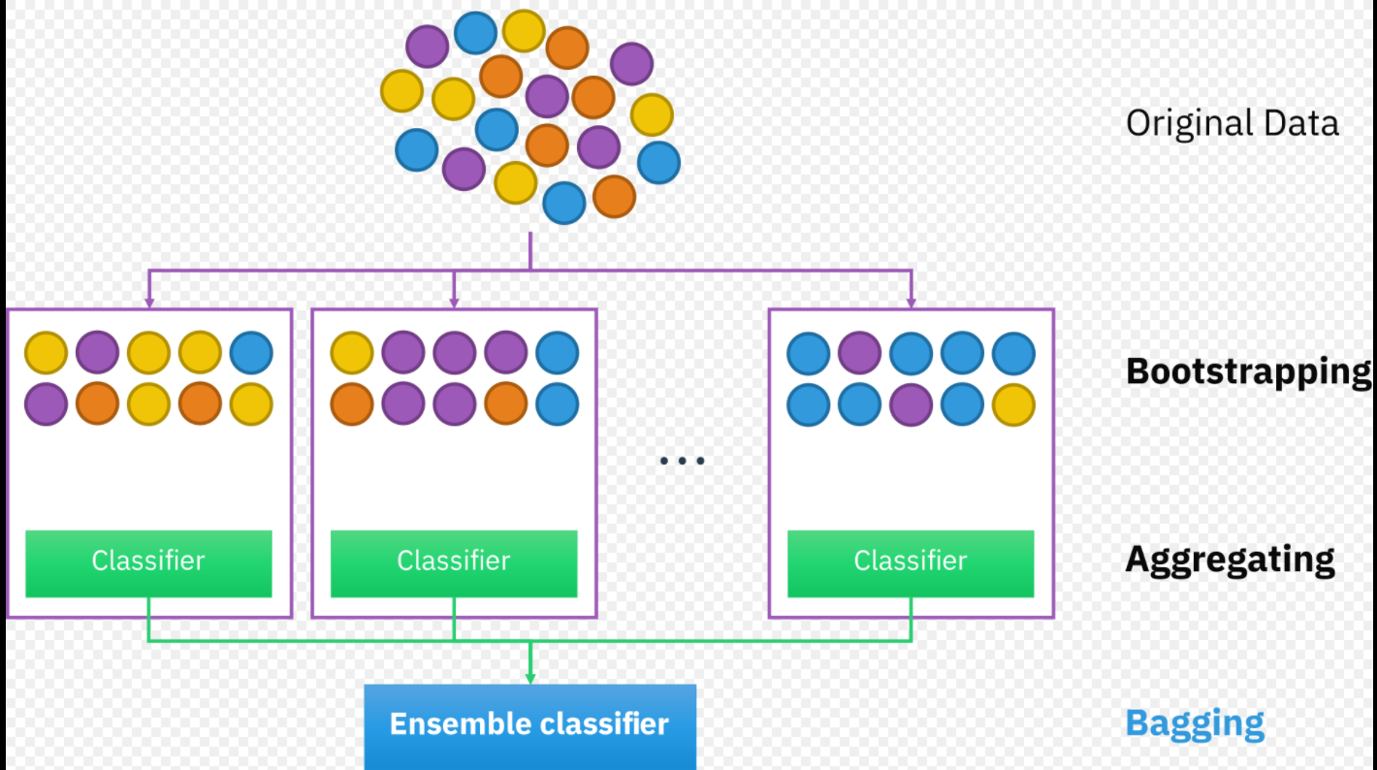
BAgging
Bootstrap aggregation, also known as bagging, is one of the earliest and simplest ensemble-based algorithms to make decision trees more robust and to achieve better performance.
concept behind bagging is to combine the predictions of several base learners to create a more accurate output.
A bootstrap is a sample of a dataset with replacement and each sample is generated by sampling uniformly the m-sized training set until a new set with m instances is obtained.
Read more: Difference Between Bagging and Random Forest | Difference Between http://www.differencebetween.net/technology/difference-between-bagging-and-random-forest/#ixzz6aopK9ugG

Slide 16
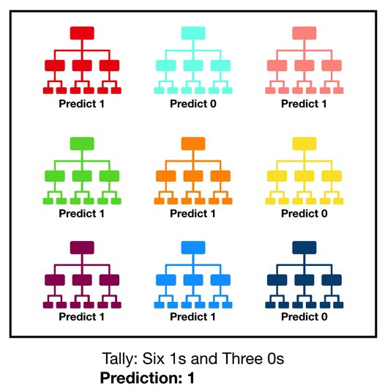
Random Forest
The random forest is a model made up of many decision trees. Rather than just simply averaging the prediction of trees (which we could call a “forest”), this model uses two key concepts that gives it the name random:
Random sampling of training data points when building trees
Random subsets of features considered when splitting nodes
The prediction is done by voting of all trees and the most common prediction is the output of the forest

Slide 17
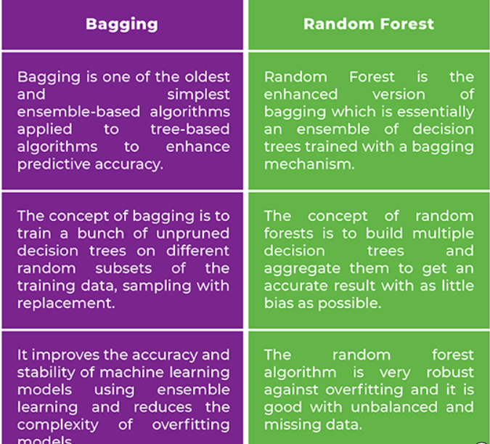
Difference between RF and bagging

Slide 18
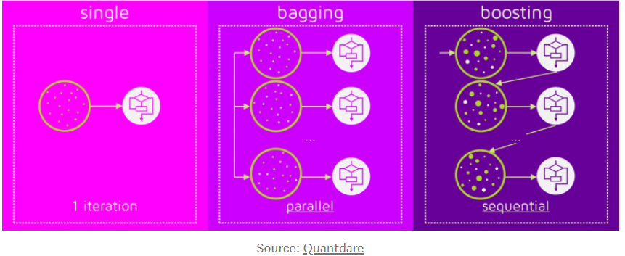
Boosting
The term ‘Boosting’ refers to a family of algorithms which converts weak learner to strong learners.
Boosting is an ensemble method for improving the model predictions of any given learning algorithm.
Boosting improves predictions sequentially. Bagging is parallel.

Slide 19
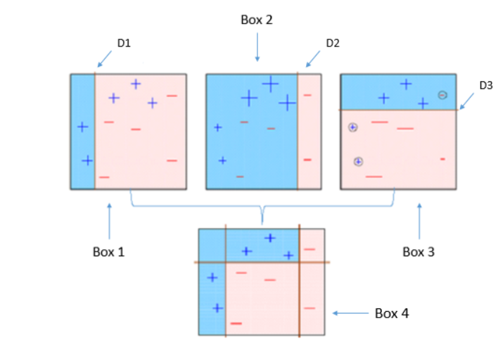
ADABoost
Stands for adaptive boosting.
The weak learners in AdaBoost are decision trees with a single split, called decision stumps.
AdaBoost creates its first decision stump, all observations are weighted equally.
To correct the previous error, the observations that were incorrectly classified now carry more weight than the observations that were correctly classified.
AdaBoost algorithms can be used for both classification and regression problem.
Source: https://medium.com/greyatom/a-quick-guide-to-boosting-in-ml-acf7c1585cb5#:~:text=What%20is%20Boosting%3F,trying%20to%20correct%20its%20predecessor.

Slide 20
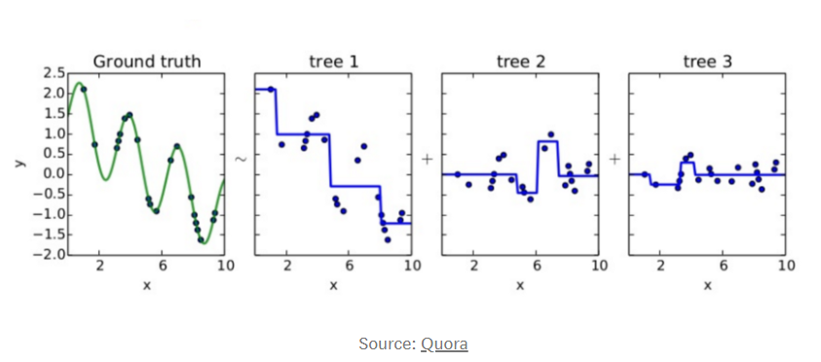
Gradient boosting
Gradient Boosting works by sequentially adding predictors to an ensemble, each one correcting its predecessor.
instead of changing the weights for every incorrect classified observation at every iteration like AdaBoost, Gradient Boosting method tries to fit the new predictor to the residual errors made by the previous predictor.
GBM uses Gradient Descent to find the shortcomings in the previous learner’s predictions. GBM algorithm can be given by following steps.
Fit a model to the data, F1(x) = y
Fit a model to the residuals, h1(x) = y−F1(x)
Create a new model, F2(x) = F1(x) + h1(x)
Source: https://medium.com/greyatom/a-quick-guide-to-boosting-in-ml-acf7c1585cb5#:~:text=What%20is%20Boosting%3F,trying%20to%20correct%20its%20predecessor.

Slide 21
XGBoost
XGBoost stands for eXtreme Gradient Boosting.
XGBoost is an implementation of gradient boosted decision trees designed for speed and performance.
Gradient boosting machines are generally very slow in implementation because of sequential model training.
Hence, they are not very scalable. Thus, XGBoost is focused on computational speed and model performance. XGBoost provides:
Parallelization of tree construction using all of your CPU cores during training.
Distributed Computing for training very large models using a cluster of machines.
Out-of-Core Computing for very large datasets that don’t fit into memory.
Cache Optimization of data structures and algorithm to make the best use of hardware.
Source: https://medium.com/greyatom/a-quick-guide-to-boosting-in-ml-acf7c1585cb5#:~:text=What%20is%20Boosting%3F,trying%20to%20correct%20its%20predecessor.

Slide 22
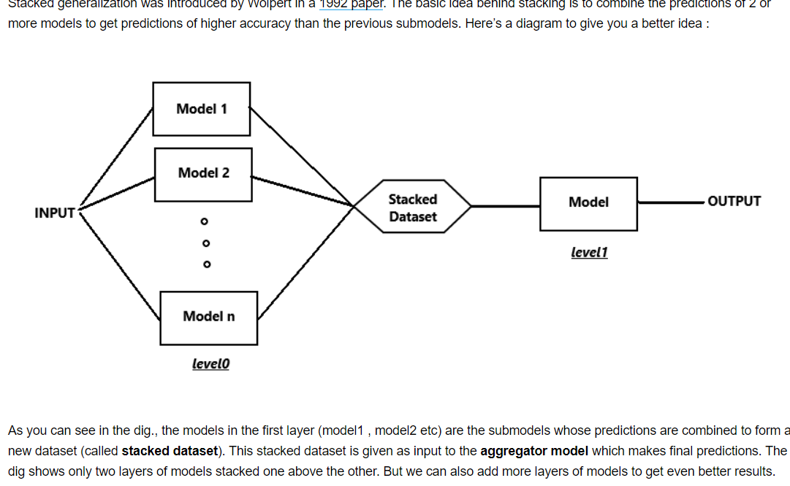
Stacking

